Slide 1

Parallel Programming in C with MPI and OpenMP
Michael J. Quinn

Slide 2
Chapter 17
Shared-memory Programming

Slide 3
Outline
OpenMP
Shared-memory model
Parallel for loops
Declaring private variables
Critical sections
Reductions
Performance improvements
More general data parallelism
Functional parallelism

Slide 4
OpenMP
OpenMP: An application programming interface (API) for parallel programming on multiprocessors
  Compiler directives
  Library of support functions
OpenMP works in conjunction with Fortran, C, or C++

Slide 5
What’s OpenMP Good For?
C + OpenMP sufficient to program multiprocessors
C + MPI + OpenMP a good way to program multicomputers built out of multiprocessors
  IBM RS/6000 SP
  Fujitsu AP3000
  Dell High Performance Computing Cluster

Slide 6
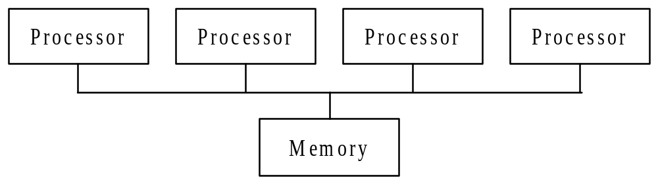
Shared-memory Model
Processors interact and synchronize with each
other through shared variables.

Slide 7
Fork/Join Parallelism
Initially only master thread is active
Master thread executes sequential code
Fork: Master thread creates or awakens additional threads to execute parallel code
Join: At end of parallel code created threads die or are suspended

Slide 8
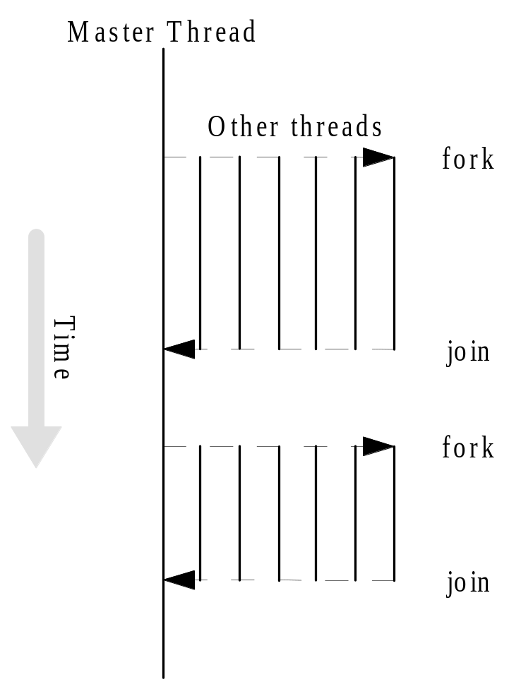
Fork/Join Parallelism

Slide 9
Shared-memory Model vs.
Message-passing Model (#1)
Shared-memory model
  Number active threads 1 at start and finish of program, changes dynamically during execution
Message-passing model
  All processes active throughout execution of program

Slide 10
Incremental Parallelization
Sequential program a special case of a shared-memory parallel program
Parallel shared-memory programs may only have a single parallel loop
Incremental parallelization: process of converting a sequential program to a parallel program a little bit at a time

Slide 11
Shared-memory Model vs.
Message-passing Model (#2)
Shared-memory model
  Execute and profile sequential program
  Incrementally make it parallel
  Stop when further effort not warranted
Message-passing model
  Sequential-to-parallel transformation requires major effort
  Transformation done in one giant step rather than many tiny steps

Slide 12
Parallel for Loops
C programs often express data-parallel operations as for loops
for (i = first; i < size; i += prime)
marked[i] = 1;
OpenMP makes it easy to indicate when the iterations of a loop may execute in parallel
Compiler takes care of generating code that forks/joins threads and allocates the iterations to threads

Slide 13
Pragmas
Pragma: a compiler directive in C or C++
Stands for “pragmatic information”
A way for the programmer to communicate with the compiler
Compiler free to ignore pragmas
Syntax:
#pragma omp <rest of pragma>

Slide 14
Parallel for Pragma
Format:
#pragma omp parallel for
for (i = 0; i < N; i++)
a[i] = b[i] + c[i];
Compiler must be able to verify the run-time system will have information it needs to schedule loop iterations

Slide 15
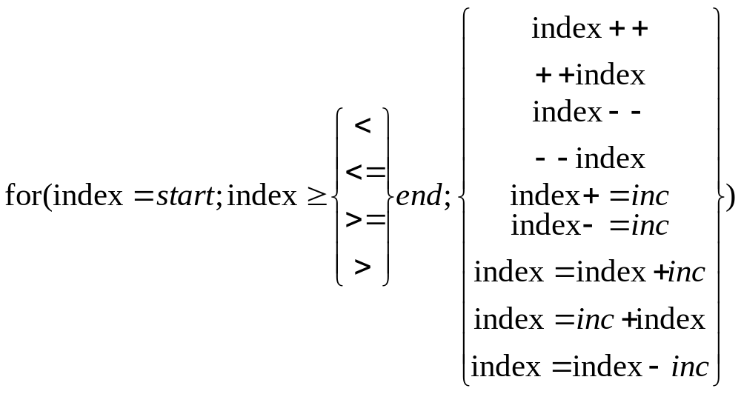
Canonical Shape of for Loop Control Clause

Slide 16
Execution Context
Every thread has its own execution context
Execution context: address space containing all of the variables a thread may access
Contents of execution context:
  static variables
  dynamically allocated data structures in the heap
  variables on the run-time stack
  additional run-time stack for functions invoked by the thread

Slide 17
Shared and Private Variables
Shared variable: has same address in execution context of every thread
Private variable: has different address in execution context of every thread
A thread cannot access the private variables of another thread

Slide 18
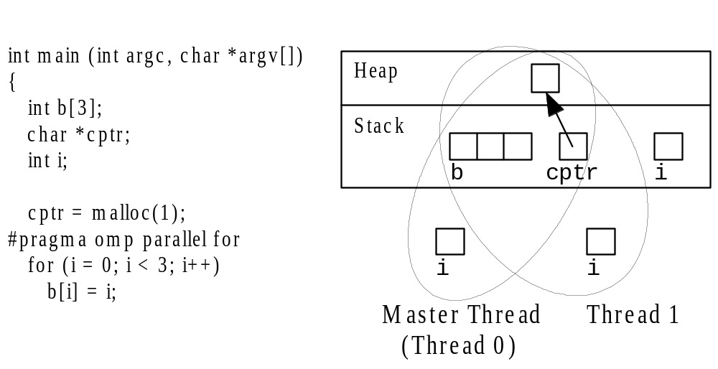
Shared and Private Variables

Slide 19
Function omp_get_num_procs
Returns number of physical processors available for use by the parallel program
int omp_get_num_procs (void)

Slide 20
Function omp_set_num_threads
Uses the parameter value to set the number of threads to be active in parallel sections of code
May be called at multiple points in a program
void omp_set_num_threads (int t)

Slide 21
Pop Quiz:
Write a C program segment that sets the number of threads equal to the number of processors that are available.

Slide 22
Declaring Private Variables
for (i = 0; i < BLOCK_SIZE(id,p,n); i++)
for (j = 0; j < n; j++)
a[i][j] = MIN(a[i][j],a[i][k]+tmp);
Either loop could be executed in parallel
We prefer to make outer loop parallel, to reduce number of forks/joins
We then must give each thread its own private copy of variable j

Slide 23
private Clause
Clause: an optional, additional component to a pragma
Private clause: directs compiler to make one or more variables private
private ( <variable list> )

Slide 24
Example Use of private Clause
#pragma omp parallel for private(j)
for (i = 0; i < BLOCK_SIZE(id,p,n); i++)
for (j = 0; j < n; j++)
a[i][j] = MIN(a[i][j],a[i][k]+tmp);

Slide 25
firstprivate Clause
Used to create private variables having initial values identical to the variable controlled by the master thread as the loop is entered
Variables are initialized once per thread, not once per loop iteration
If a thread modifies a variable’s value in an iteration, subsequent iterations will get the modified value

Slide 26
lastprivate Clause
Sequentially last iteration: iteration that occurs last when the loop is executed sequentially
lastprivate clause: used to copy back to the master thread’s copy of a variable the private copy of the variable from the thread that executed the sequentially last iteration

Slide 27
Critical Sections
double area, pi, x;
int i, n;
...
area = 0.0;
for (i = 0; i < n; i++) {
x += (i+0.5)/n;
area += 4.0/(1.0 + x*x);
}
pi = area / n;

Slide 28
Race Condition
Consider this C program segment to compute π using the rectangle rule:
double area, pi, x;
int i, n;
...
area = 0.0;
for (i = 0; i < n; i++) {
x = (i+0.5)/n;
area += 4.0/(1.0 + x*x);
}
pi = area / n;

Slide 29
Race Condition (cont.)
If we simply parallelize the loop...
double area, pi, x;
int i, n;
...
area = 0.0;
#pragma omp parallel for private(x)
for (i = 0; i < n; i++) {
x = (i+0.5)/n;
area += 4.0/(1.0 + x*x);
}
pi = area / n;

Slide 30
Race Condition (cont.)
... we set up a race condition in which one process may “race ahead” of another and not see its change to shared variable area
11.667
15.432
area
15.230
Answer should be 18.995
11.667
15.432
11.667
15.230
Thread A
Thread B
area += 4.0/(1.0 + x*x)

Slide 31
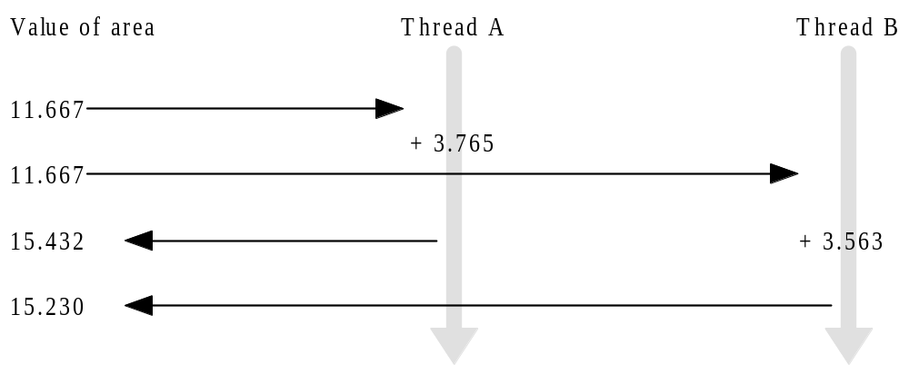
Race Condition Time Line

Slide 32
critical Pragma
Critical section: a portion of code that only thread at a time may execute
We denote a critical section by putting the pragma
#pragma omp critical
in front of a block of C code

Slide 33
Correct, But Inefficient, Code
double area, pi, x;
int i, n;
...
area = 0.0;
#pragma omp parallel for private(x)
for (i = 0; i < n; i++) {
x = (i+0.5)/n;
#pragma omp critical
area += 4.0/(1.0 + x*x);
}
pi = area / n;

Slide 34
Source of Inefficiency
Update to area inside a critical section
Only one thread at a time may execute the statement; i.e., it is sequential code
Time to execute statement significant part of loop
By Amdahl’s Law we know speedup will be severely constrained

Slide 35
Reductions
Reductions are so common that OpenMP provides support for them
May add reduction clause to parallel for pragma
Specify reduction operation and reduction variable
OpenMP takes care of storing partial results in private variables and combining partial results after the loop

Slide 36
reduction Clause
The reduction clause has this syntax:
reduction (<op> :<variable>)
Operators
  + Sum
  * Product
  & Bitwise and
  | Bitwise or
  ^ Bitwise exclusive or
  && Logical and
  || Logical or

Slide 37
π-finding Code with Reduction Clause
double area, pi, x;
int i, n;
...
area = 0.0;
#pragma omp parallel for \
private(x) reduction(+:area)
for (i = 0; i < n; i++) {
x = (i + 0.5)/n;
area += 4.0/(1.0 + x*x);
}
pi = area / n;

Slide 38
Performance Improvement #1
Too many fork/joins can lower performance
Inverting loops may help performance if
  Parallelism is in inner loop
  After inversion, the outer loop can be made parallel
  Inversion does not significantly lower cache hit rate

Slide 39
Performance Improvement #2
If loop has too few iterations, fork/join overhead is greater than time savings from parallel execution
The if clause instructs compiler to insert code that determines at run-time whether loop should be executed in parallel; e.g.,
#pragma omp parallel for if(n > 5000)

Slide 40
Performance Improvement #3
We can use schedule clause to specify how iterations of a loop should be allocated to threads
Static schedule: all iterations allocated to threads before any iterations executed
Dynamic schedule: only some iterations allocated to threads at beginning of loop’s execution. Remaining iterations allocated to threads that complete their assigned iterations.

Slide 41
Static vs. Dynamic Scheduling
Static scheduling
  Low overhead
  May exhibit high workload imbalance
Dynamic scheduling
  Higher overhead
  Can reduce workload imbalance

Slide 42
Chunks
A chunk is a contiguous range of iterations
Increasing chunk size reduces overhead and may increase cache hit rate
Decreasing chunk size allows finer balancing of workloads

Slide 43
schedule Clause
Syntax of schedule clause
schedule (<type>[,<chunk> ])
Schedule type required, chunk size optional
Allowable schedule types
  static: static allocation
  dynamic: dynamic allocation
  guided: guided self-scheduling
  runtime: type chosen at run-time based on value of environment variable OMP_SCHEDULE

Slide 44
Scheduling Options
schedule(static): block allocation of about n/t contiguous iterations to each thread
schedule(static,C): interleaved allocation of chunks of size C to threads
schedule(dynamic): dynamic one-at-a-time allocation of iterations to threads
schedule(dynamic,C): dynamic allocation of C iterations at a time to threads

Slide 45
Scheduling Options (cont.)
schedule(guided, C): dynamic allocation of chunks to tasks using guided self-scheduling heuristic. Initial chunks are bigger, later chunks are smaller, minimum chunk size is C.
schedule(guided): guided self-scheduling with minimum chunk size 1
schedule(runtime): schedule chosen at run-time based on value of OMP_SCHEDULE; Unix example:
setenv OMP_SCHEDULE “static,1”

Slide 46
More General Data Parallelism
Our focus has been on the parallelization of for loops
Other opportunities for data parallelism
  processing items on a “to do” list
  for loop + additional code outside of loop

Slide 47
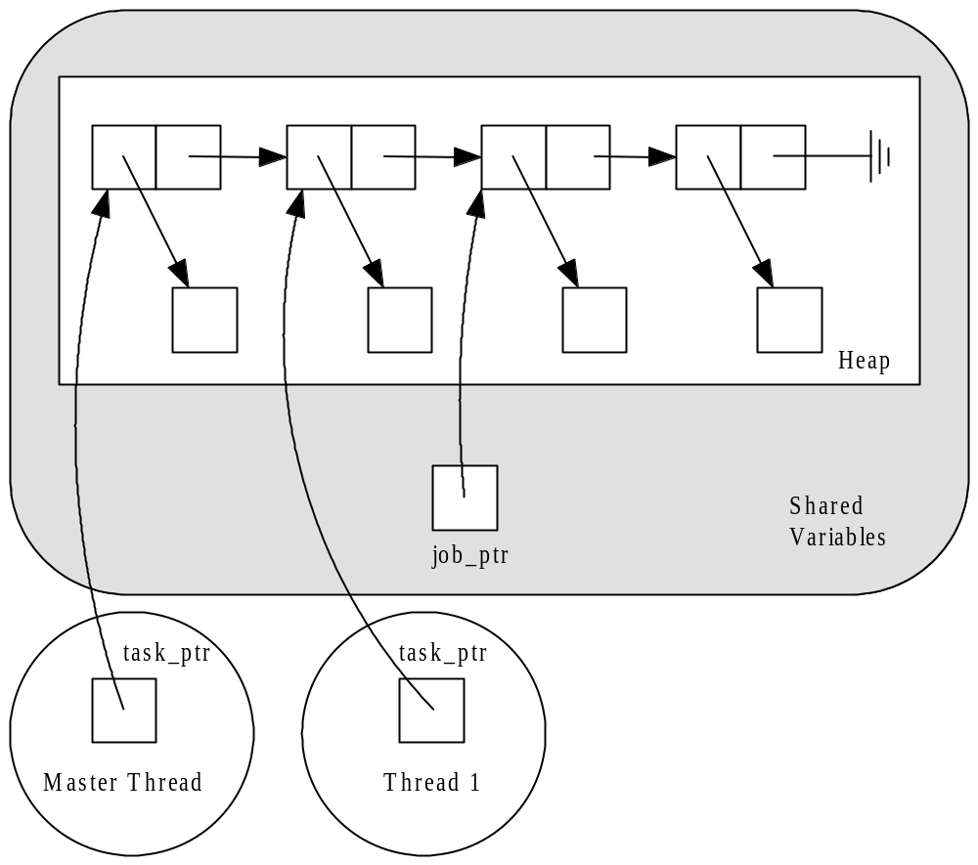
Processing a “To Do” List

Slide 48
Sequential Code (1/2)
int main (int argc, char *argv[])
{
struct job_struct *job_ptr;
struct task_struct *task_ptr;
...
task_ptr = get_next_task (&job_ptr);
while (task_ptr != NULL) {
complete_task (task_ptr);
task_ptr = get_next_task (&job_ptr);
}
...
}

Slide 49
Sequential Code (2/2)
char *get_next_task(struct job_struct
**job_ptr) {
struct task_struct *answer;
if (*job_ptr == NULL) answer = NULL;
else {
answer = (*job_ptr)->task;
*job_ptr = (*job_ptr)->next;
}
return answer;
}

Slide 50
Parallelization Strategy
Every thread should repeatedly take next task from list and complete it, until there are no more tasks
We must ensure no two threads take same take from the list; i.e., must declare a critical section

Slide 51
parallel Pragma
The parallel pragma precedes a block of code that should be executed by all of the threads
Note: execution is replicated among all threads

Slide 52
Use of parallel Pragma
#pragma omp parallel private(task_ptr)
{
task_ptr = get_next_task (&job_ptr);
while (task_ptr != NULL) {
complete_task (task_ptr);
task_ptr = get_next_task (&job_ptr);
}
}

Slide 53
Critical Section for get_next_task
char *get_next_task(struct job_struct
**job_ptr) {
struct task_struct *answer;
#pragma omp critical
{
if (*job_ptr == NULL) answer = NULL;
else {
answer = (*job_ptr)->task;
*job_ptr = (*job_ptr)->next;
}
}
return answer;
}

Slide 54
Functions for SPMD-style Programming
The parallel pragma allows us to write SPMD-style programs
In these programs we often need to know number of threads and thread ID number
OpenMP provides functions to retrieve this information

Slide 55
Function omp_get_thread_num
This function returns the thread identification number
If there are t threads, the ID numbers range from 0 to t-1
The master thread has ID number 0
int omp_get_thread_num (void)

Slide 56
Function omp_get_num_threads
Function omp_get_num_threads returns the number of active threads
If call this function from sequential portion of program, it will return 1
int omp_get_num_threads (void)

Slide 57
for Pragma
The parallel pragma instructs every thread to execute all of the code inside the block
If we encounter a for loop that we want to divide among threads, we use the for pragma
#pragma omp for

Slide 58
Example Use of for Pragma
#pragma omp parallel private(i,j)
for (i = 0; i < m; i++) {
low = a[i];
high = b[i];
if (low > high) {
printf ("Exiting (%d)\n", i);
break;
}
#pragma omp for
for (j = low; j < high; j++)
c[j] = (c[j] - a[i])/b[i];
}

Slide 59
single Pragma
Suppose we only want to see the output once
The single pragma directs compiler that only a single thread should execute the block of code the pragma precedes
Syntax:
#pragma omp single

Slide 60
Use of single Pragma
#pragma omp parallel private(i,j)
for (i = 0; i < m; i++) {
low = a[i];
high = b[i];
if (low > high) {
#pragma omp single
printf ("Exiting (%d)\n", i);
break;
}
#pragma omp for
for (j = low; j < high; j++)
c[j] = (c[j] - a[i])/b[i];
}

Slide 61
nowait Clause
Compiler puts a barrier synchronization at end of every parallel for statement
In our example, this is necessary: if a thread leaves loop and changes low or high, it may affect behavior of another thread
If we make these private variables, then it would be okay to let threads move ahead, which could reduce execution time

Slide 62
Use of nowait Clause
#pragma omp parallel private(i,j,low,high)
for (i = 0; i < m; i++) {
low = a[i];
high = b[i];
if (low > high) {
#pragma omp single
printf ("Exiting (%d)\n", i);
break;
}
#pragma omp for nowait
for (j = low; j < high; j++)
c[j] = (c[j] - a[i])/b[i];
}

Slide 63
Functional Parallelism
To this point all of our focus has been on exploiting data parallelism
OpenMP allows us to assign different threads to different portions of code (functional parallelism)

Slide 64
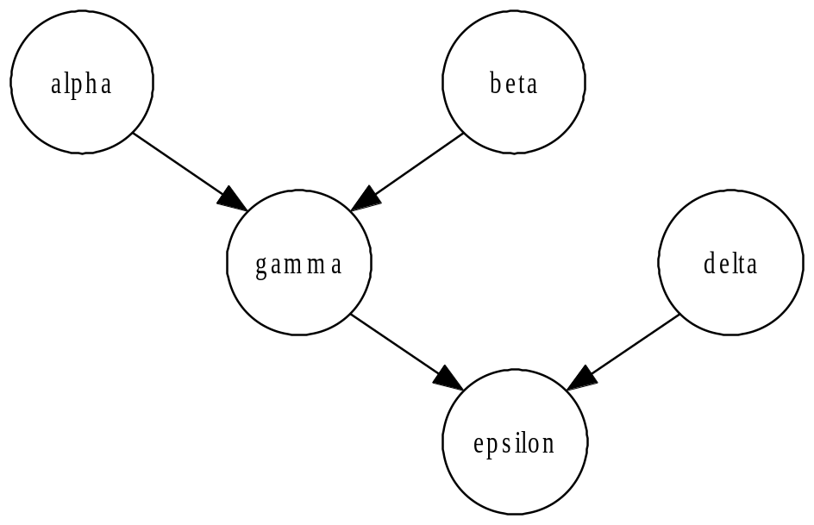
Functional Parallelism Example
v = alpha();
w = beta();
x = gamma(v, w);
y = delta();
printf ("%6.2f\n", epsilon(x,y));
May execute alpha,
beta, and delta in
parallel

Slide 65
parallel sections Pragma
Precedes a block of k blocks of code that may be executed concurrently by k threads
Syntax:
#pragma omp parallel sections

Slide 66
section Pragma
Precedes each block of code within the encompassing block preceded by the parallel sections pragma
May be omitted for first parallel section after the parallel sections pragma
Syntax:
#pragma omp section

Slide 67
Example of parallel sections
#pragma omp parallel sections
{
#pragma omp section /* Optional */
v = alpha();
#pragma omp section
w = beta();
#pragma omp section
y = delta();
}
x = gamma(v, w);
printf ("%6.2f\n", epsilon(x,y));

Slide 68
Another Approach
Execute alpha and
beta in parallel.
Execute gamma and
delta in parallel.

Slide 69
sections Pragma
Appears inside a parallel block of code
Has same meaning as the parallel sections pragma
If multiple sections pragmas inside one parallel block, may reduce fork/join costs

Slide 70
Use of sections Pragma
#pragma omp parallel
{
#pragma omp sections
{
v = alpha();
#pragma omp section
w = beta();
}
#pragma omp sections
{
x = gamma(v, w);
#pragma omp section
y = delta();
}
}
printf ("%6.2f\n", epsilon(x,y));

Slide 71
Summary (1/3)
OpenMP an API for shared-memory parallel programming
Shared-memory model based on fork/join parallelism
Data parallelism
  parallel for pragma
  reduction clause

Slide 72
Summary (2/3)
Functional parallelism (parallel sections pragma)
SPMD-style programming (parallel pragma)
Critical sections (critical pragma)
Enhancing performance of parallel for loops
  Inverting loops
  Conditionally parallelizing loops
  Changing loop scheduling

Slide 73
Summary (3/3)
Characteristic | OpenMP | MPI
Suitable for multiprocessors | Yes | Yes
Suitable for multicomputers | No | Yes
Supports incremental parallelization | Yes | No
Minimal extra code | Yes | No
Explicit control of memory hierarchy | No | Yes

